Slide 1
↱
FAKE NEWS DETECTION
↲
Group Name 3.14
Group Members Dan T Do - Daniel Herfurth - Felix Poley - Lucas Vianna
Date 3/5/2022

Slide 2

[ Why did we choose this topic? ]

Slide 3


Slide 4
[ Synopsis ]
The real world implications of misinformation in the press are far reaching and ever present in our society.
In order to fight the oncoming tide of misinformation, it is necessary to first be able to identify and sort out fake news with leading, biased language from neutral sources of information.
Once a model can be trained to do this effectively, one no longer needs to rely on human interpreters to identify misinformation, thus drastically increasing the speed at which articles can be classified.

Slide 5
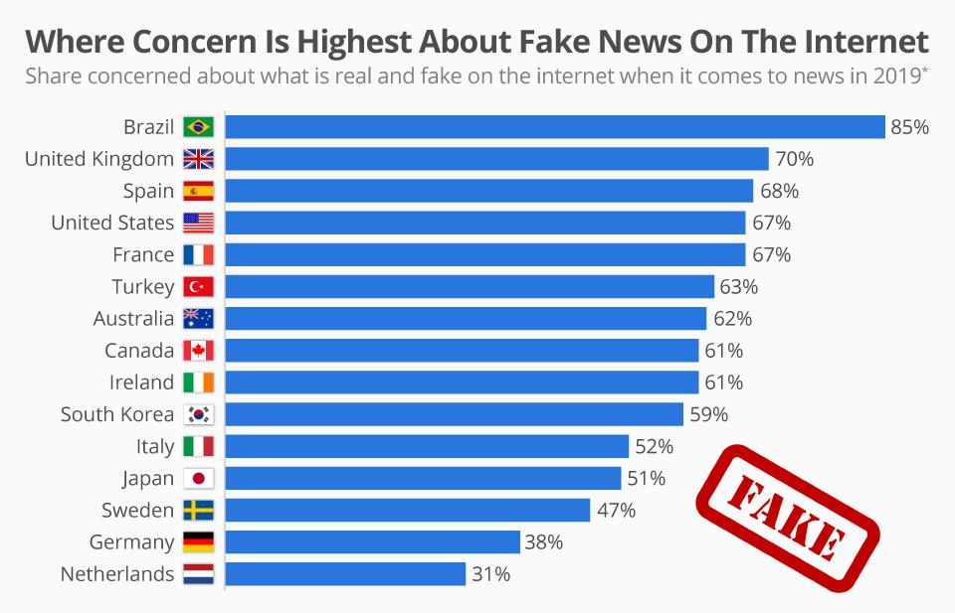
[ Inspiration ]
Popularity of Fake News on social media.
Researching in NLP
Countermeasures
Current state

Slide 6

[ The Problem To Be Solved ]
To recognize and differentiate between real and fake news stories.

Slide 7

[ Workflow ]
1
Data Processing
2
3
Text Encoding
Developing - Training - Evaluating
MODELS
4
Deploy to Production
Updating Models - Data
5

Slide 8
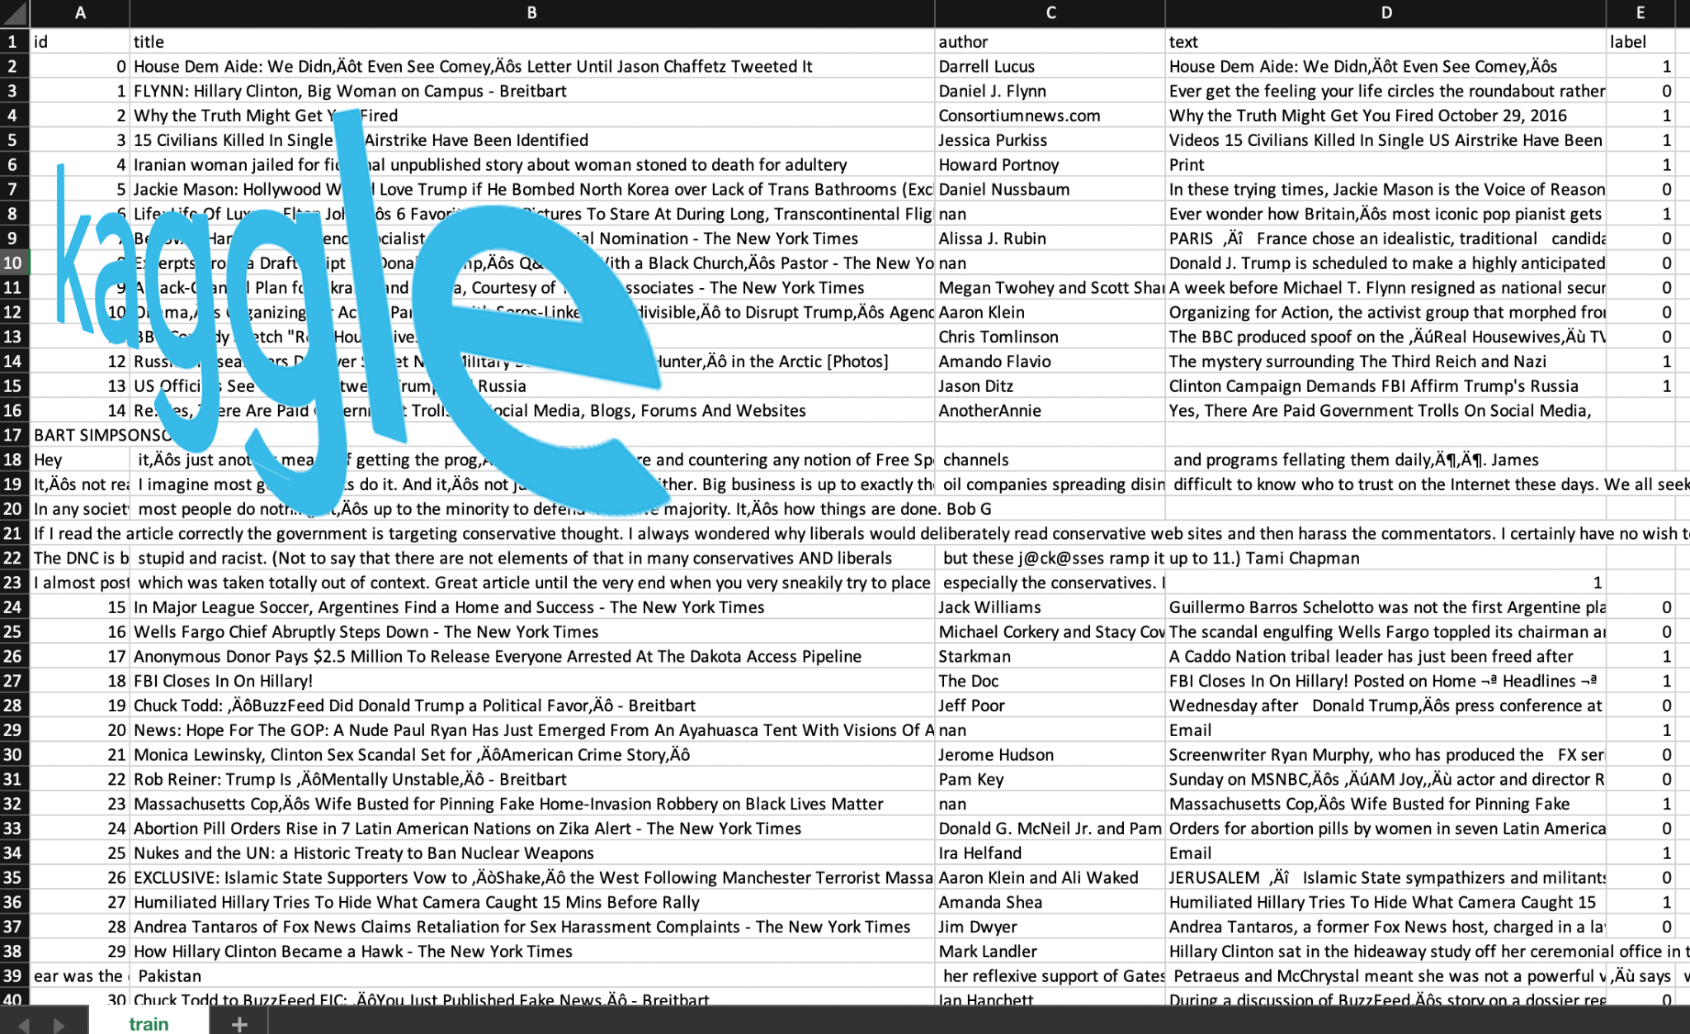

[ Datasets ]
id
title
author
text
label ( 0 - 1)

Slide 9
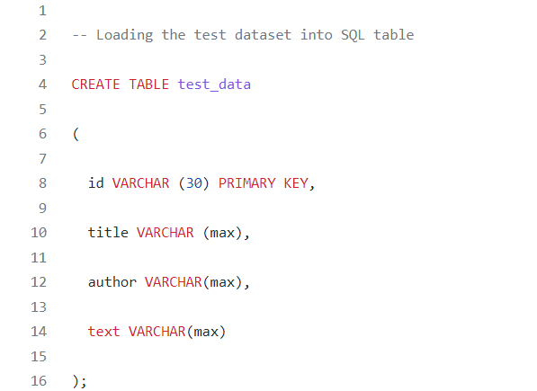
[Data Loading 1]

Slide 10
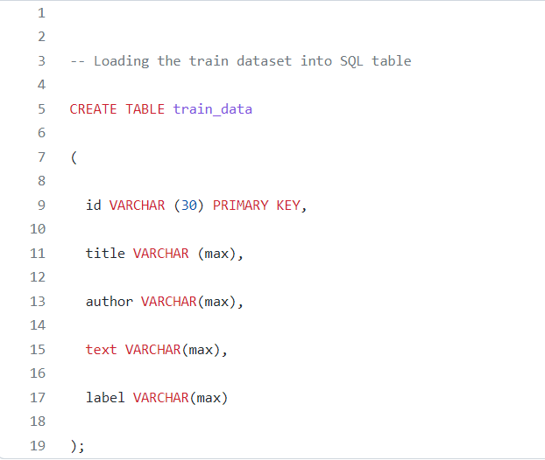
[Data Loading 2]

Slide 11
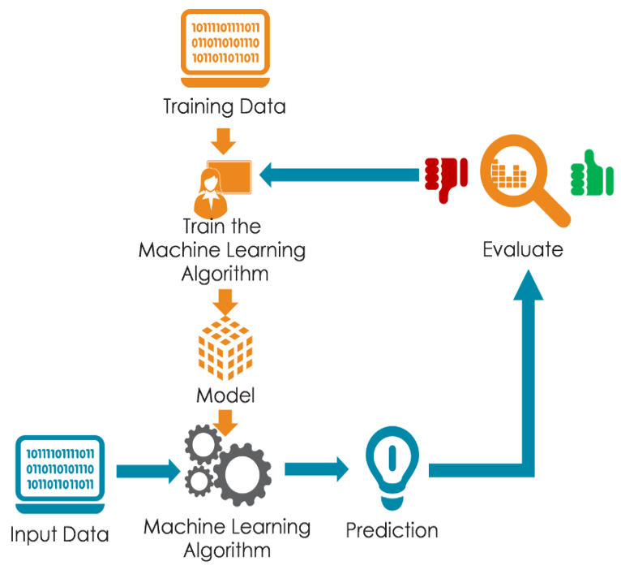
[ Models Training ]
Naive Bayes
Support Vector Machine
Neural Network
Long Short - Term Memory ( LSTM )

Slide 12
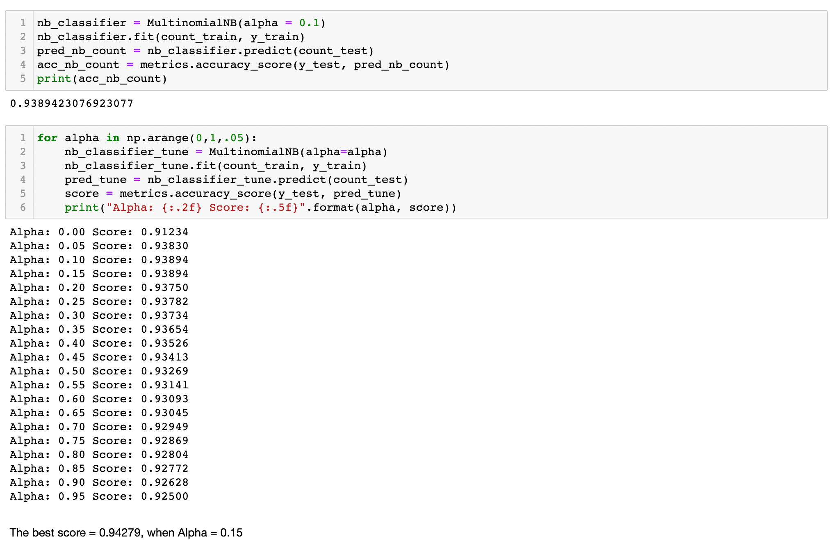
[ Count Vectorizer and TF-IDF Vectorizer ]

Slide 13
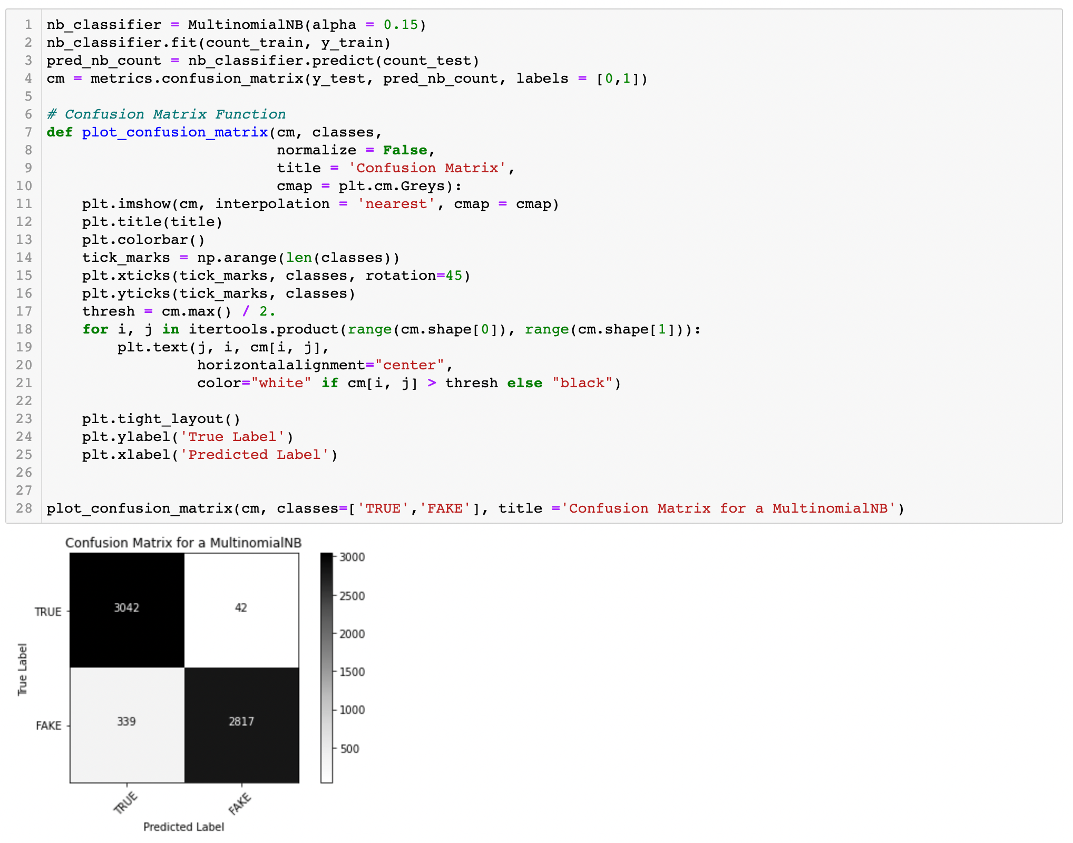

Slide 14
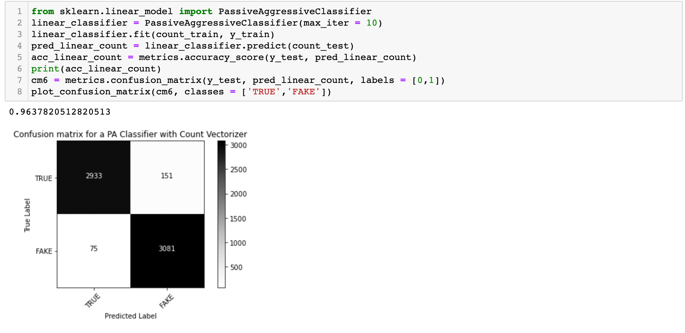
[ Passive Agressive Classifier With Count Vectorizer ]

Slide 15
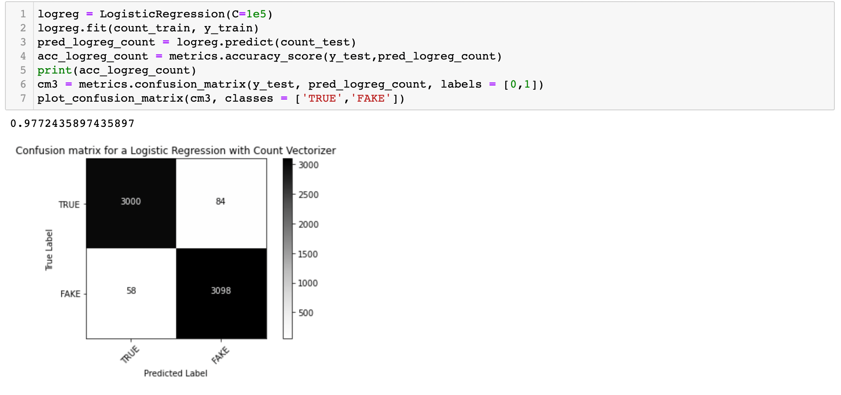
[ Logistic Regression with Count Vectorizer ]

Slide 16
[ Comparison of MODELS ]
MODELS | Precision | Recall | F1
Naive Bayes | 0.68 | 0.86 | 0.76
SVM | 0.85 | 0.93 | 0.89
Neural Network with TensorFlow | 0.77 | 0.92 | 0.84
Neural Network with Keras | 0.92 | 0.93 | 0.92
LSTM | 0.94 | 0.94 | 0.94

Slide 17
[ Data Visualizations ]

Slide 18
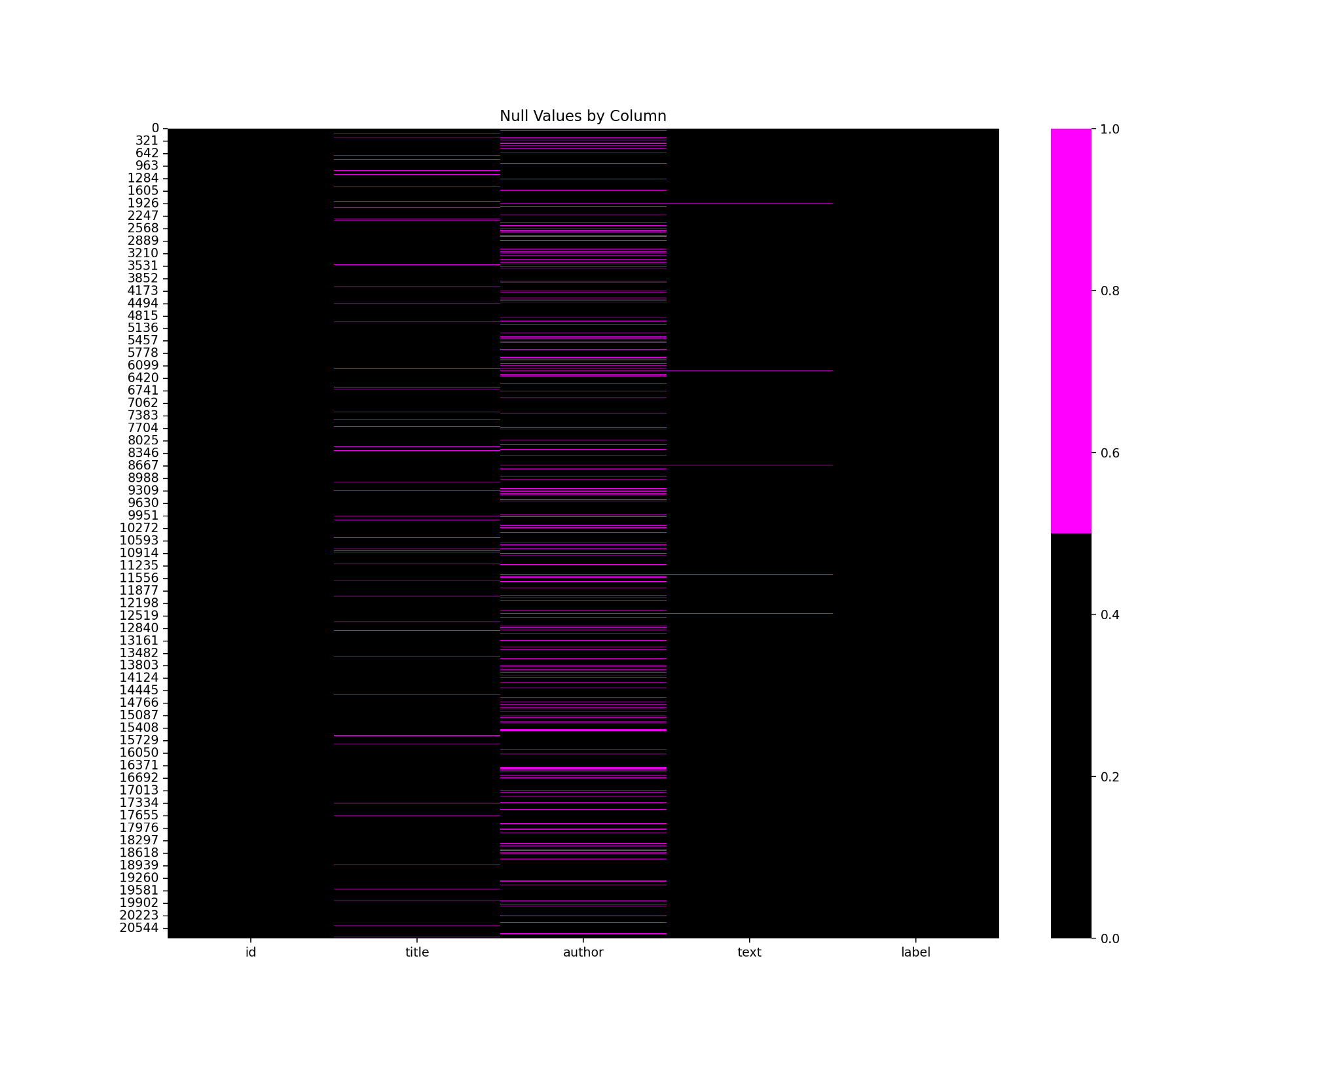
Null Values based on Column

Slide 19
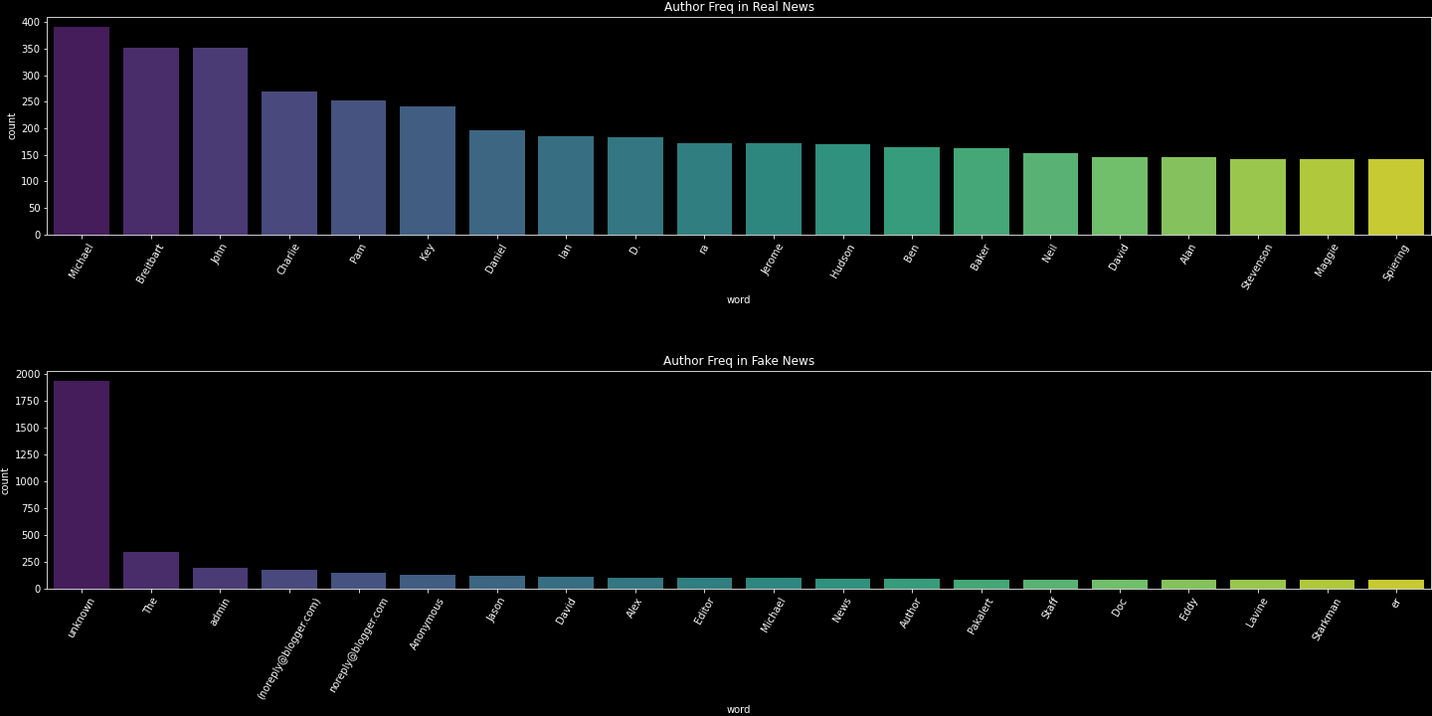
Author Frequency

Slide 20
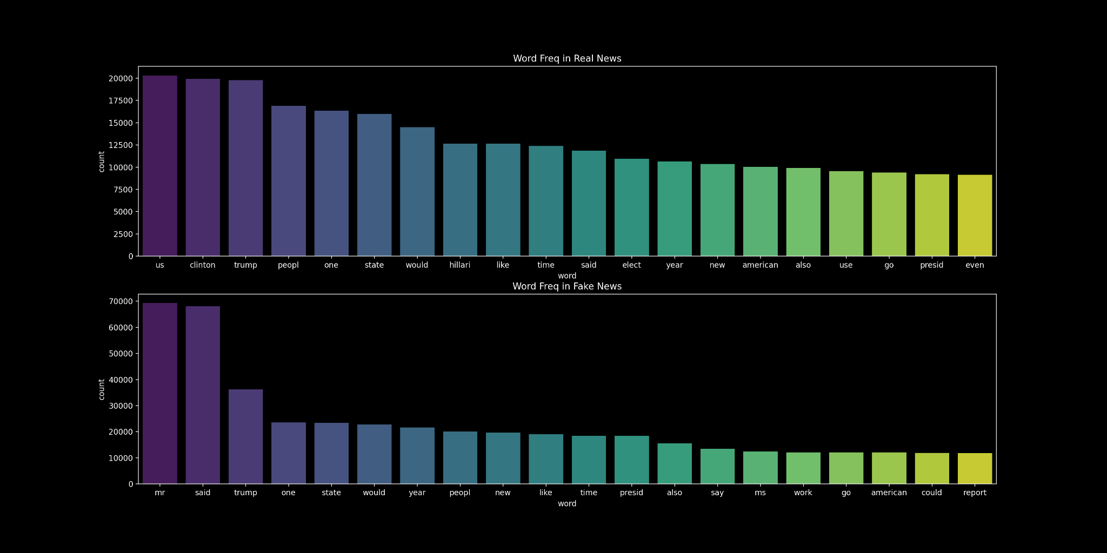
Word Frequency

Slide 21
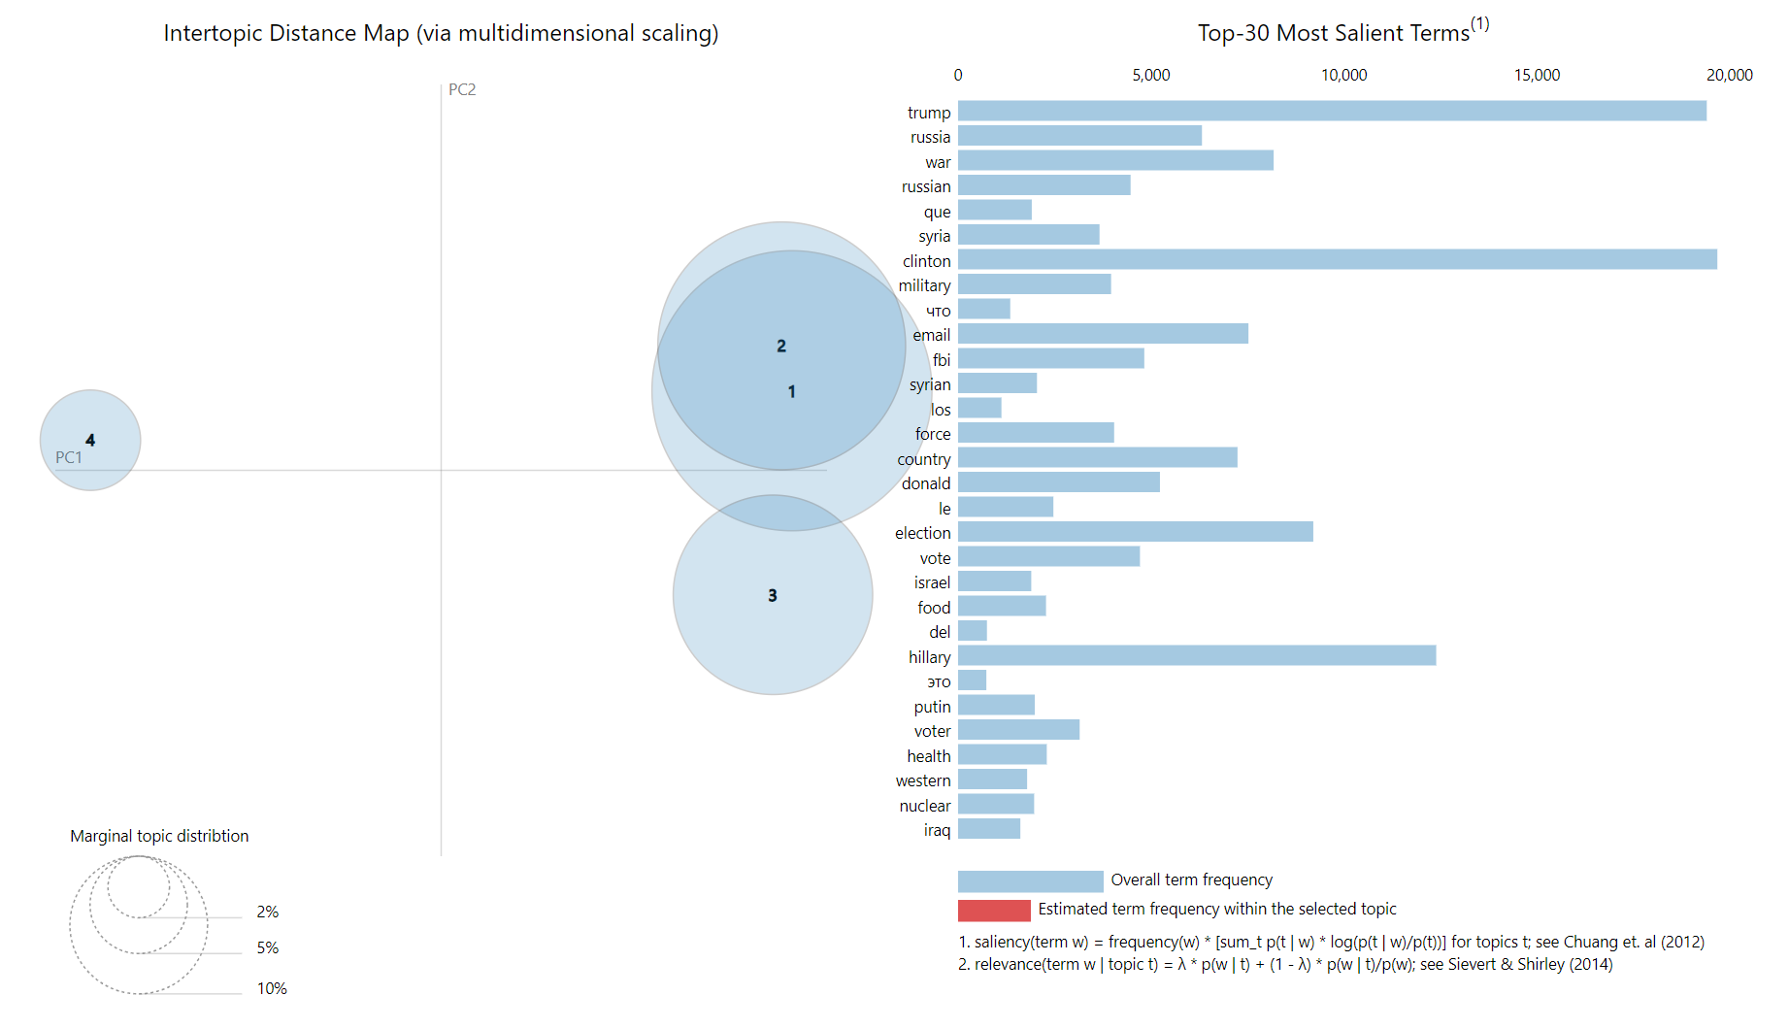
Fake News – Text

Slide 22
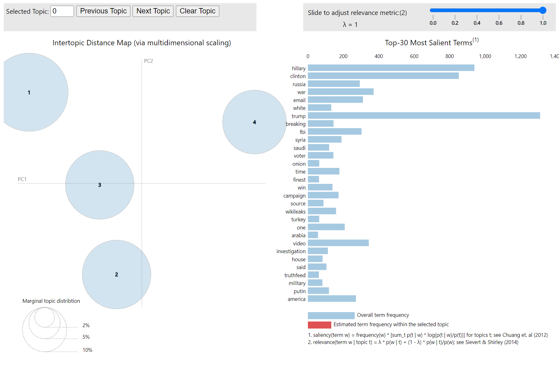
Fake News – Title

Slide 23
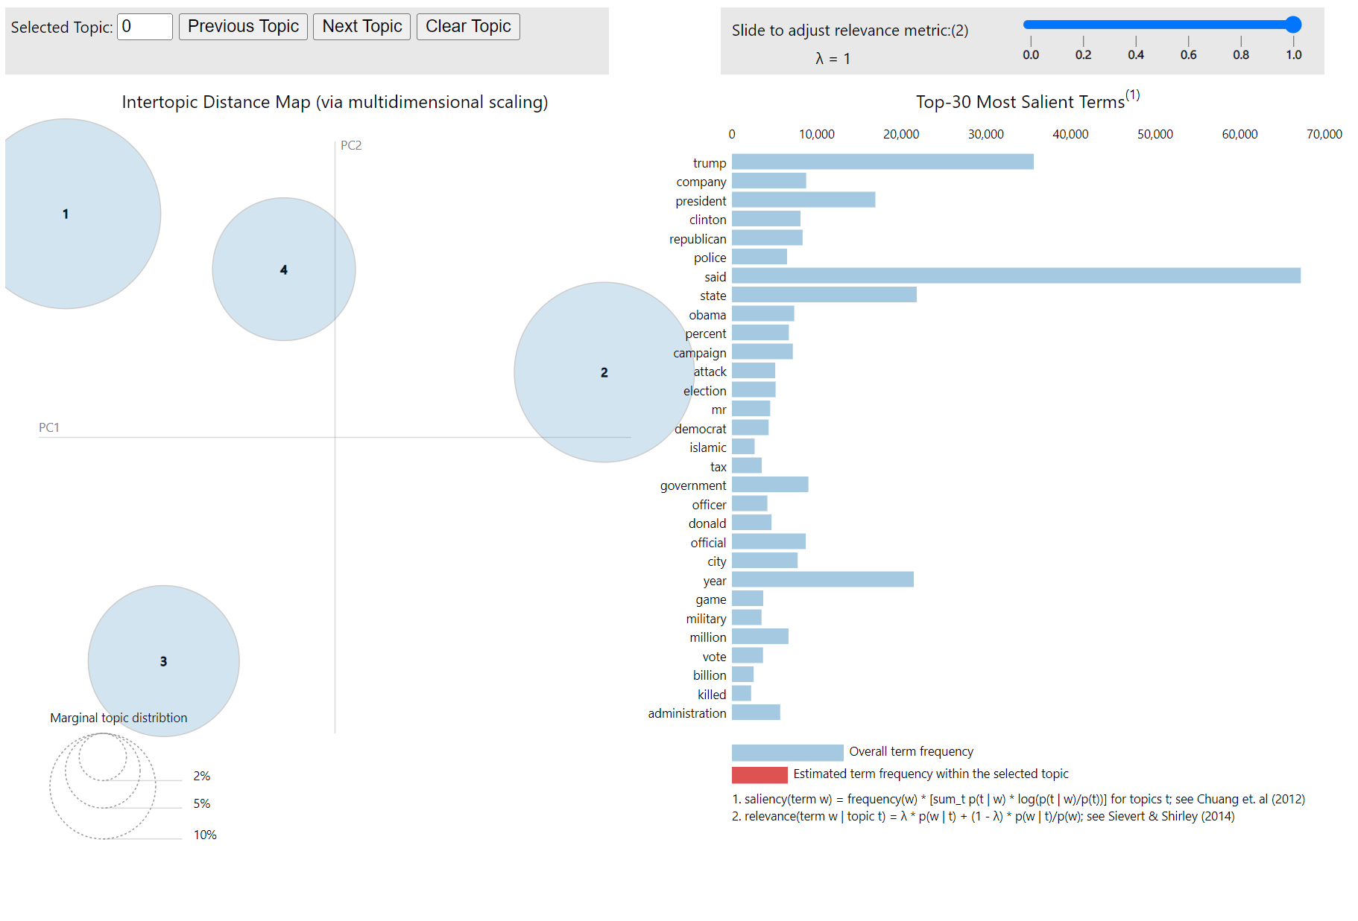
Real News – Text

Slide 24
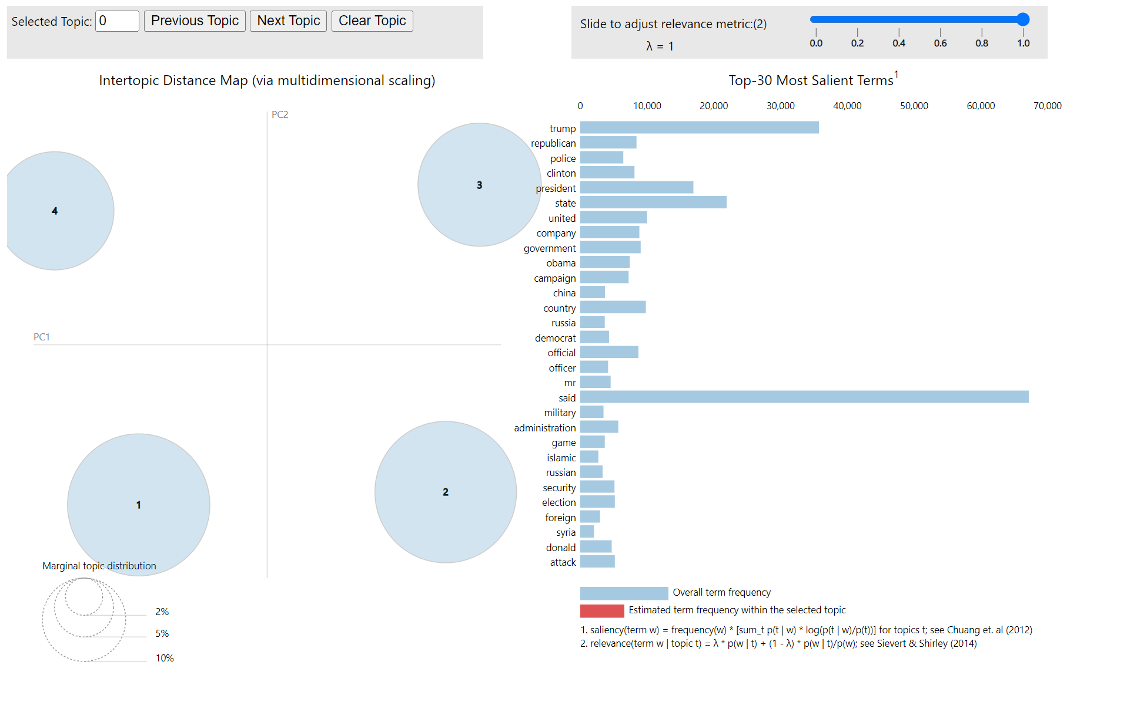
Real News – Title

Slide 25
↱
DATA’S IT !
↲

